Slide 1
Predicting Interest Rates
Statistical Models

Slide 2
Economic vs. Statistical Models
Economic models are designed to match correlations between interest rates and other economic aggregate variables
  Pro: Economic (structural) models use all the latest information available to predict interest rate movements
  Con: They require a lot of data, the equation can be quite complex, and over longer time periods are very inaccurate

Slide 3
Economic vs. Statistical Models
Statistical models are designed to match the dynamics of interest rates and the yield curve using past behavior.
  Pro: Statistical Models require very little data and are generally easy to calculate
  Con: Statistical models rely entirely on the past. They don’t incorporate new information.

Slide 4
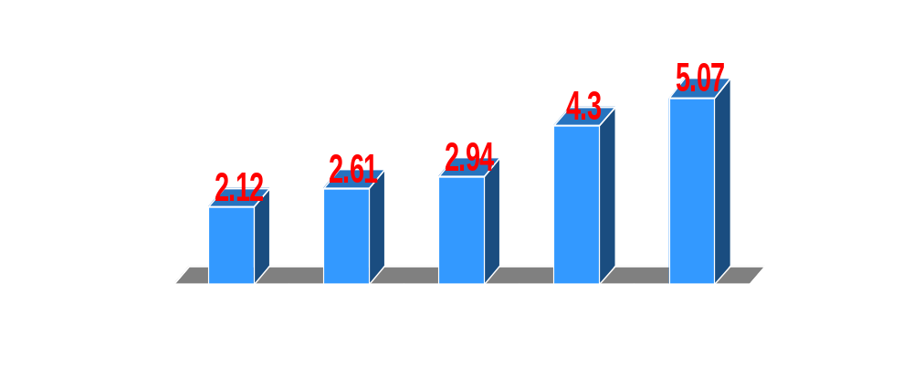
The Yield Curve
S(1)
S(2)
S(5)
S(10)
S(20)
Recall that the yield curve is a collection of current spot rates

Slide 5
Forward Rates
Forward rates are interest rates for contracts to be written in the future. (F)
    F(1,1) = Interest rate on 1 year loans contracted 1 year from now
    F(1,2) = Interest rate on 2 yr loans contracted 2 years from now
    F(2,1) = interest rate on 1 year loans contracted 2 years from now
    S(1) = F(0,1)

Slide 6
Spot/Forward Rates
S(3)
Spot Rates
S(2)
S(1)
Now
1yr
2yrs
3yrs
4yrs
5yrs
F(0,1)
F(1,1)
F(2,1)
F(0,2)
F(2,2)
Forward Rates
F(1,2)
F(1,3)

Slide 7
Calculating Forward Rates
Forward rates are not observed, but are implied in the yield curve
Suppose the current annual yield on a 2 yr Treasury is 2.61% while a 1 yr Treasury pays an annual rate of 2.12%
S(2)
2.61%/yr
S(1)
2.12%/yr
Now
1yr
2yrs
3yrs
4yrs
5yrs
F(1,1)

Slide 8
Calculating Forward Rates
S(2)
2.61%/yr
S(1)
2.12%/yr
Now
1yr
2yrs
3yrs
4yrs
5yrs
F(1,1)
Strategy #1: Invest $1 in a two year Treasury
Strategy #2: Invest $1 in a 1 year Treasury and then reinvest in 1 year
$1(1.0261)(1.0261) = 1.053 (5.3%)
$1(1.0212)(1 + F(1,1))
For these strategies, to pay the same return, the one year forward rate would need to be 3.1%
$1(1.0261)(1.0261) = $1(1.0261)(1+F(1,1)
$1(1.0261)(1.0261)
1+F(1,1) =
$1(1.0212)
=1.031

Slide 9
Calculating Spot Rates
We can also do this in reverse. If we knew the path for forward rates, we can calculate the spot rates:
S(3)
???
S(2)
???
S(1)
2%
Now
1yr
2yrs
3yrs
4yrs
5yrs
2%
3.3%
2.9%

Slide 10
Calculating Spot Rates
S(2)
???
Now
1yr
2yrs
3yrs
4yrs
5yrs
2%
3.3%
Strategy #1: Invest $1 in a two year Treasury
Strategy #1: Invest $1 in a 1 year Treasury and then reinvest in 1 year
$1(1+(S(2))(1+S(2))
$1(1.02)(1.033) = 1.054 (5.4%)
For these strategies, to pay the same return, the two year spot rate would need to be 2.6%
2
$1(1.02)(1.033) = $1(1+S(2))
1/2
1+S(2) =
((1.02)(1.033))
=1.026

Slide 11
Arithmetic vs. Geometric Averages
S(2)
2.6%
Now
1yr
2yrs
3yrs
4yrs
5yrs
2%
3.3%
In the previous example, we calculated the Geometric Average of expected forward rates to get the current spot rate
1/2
1+S(2) =
((1.02)(1.033))
=1.026 (2.6%)
The Arithmetic Average is generally a good approximation
2% + 3.3%
S(2) =
= 2.65%
2

Slide 12
Spot rates are equal to the averages of the corresponding forward rates (expectations hypothesis)
S(3)
2.73%
S(2)
2.65%
S(1)
2%
Now
1yr
2yrs
3yrs
4yrs
5yrs
2%
3.3%
2.9%
2% + 3.3%
2% + 3.3% + 2.9%
= 2.73%
S(2) =
= 2.65%
S(3) =
2
3

Slide 13
However, the expectations hypothesis assumes that investing in long term bonds is an equivalent strategy to investing in short term bonds
This rate is “locked in” at time 0
S(2)
2.65%
Now
1yr
2yrs
3yrs
4yrs
5yrs
2%
3.3%
This rate is flexible at time 0
Long term bondholders should be compensated for inflexibility of their portfolios by adding a “liquidity premium” to longer term rates (preferred habitat hypothesis)

Slide 14
Statistical Models
Now
1yr
2yrs
3yrs
4yrs
5yrs
F(0,1)
F(1,1)
F(2,1)
F(3,1)
3.3%
F(4,1)
First, write down a model to explain movements in the forward rates
Then, calculate the yield curve implied by the forward rates. Does it look like the actual yield curve?
S(3)
S(2)
S(1)
Now
1yr
2yrs
3yrs
4yrs
5yrs

Slide 15
Lattice Methods (Discrete)
Lattice models assume that the interest rate makes discrete jumps between time periods (usually calibrated monthly)
    Binomial: Two Possibilities each Period
    Trinomial: Three Possibilities each Period

Slide 16
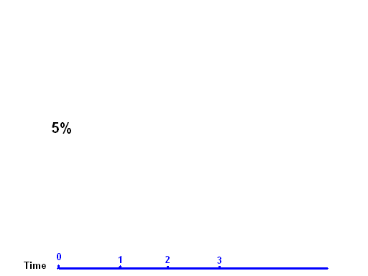
An Example
At time zero, the interest rate 5%: F(0,1) = S(1)

Slide 17
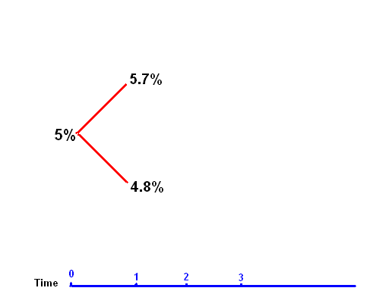
An Example
In the first year, the interest rate has a 50% chance of rising to 5.7% or falling to 4.8%: F(1,1)

Slide 18
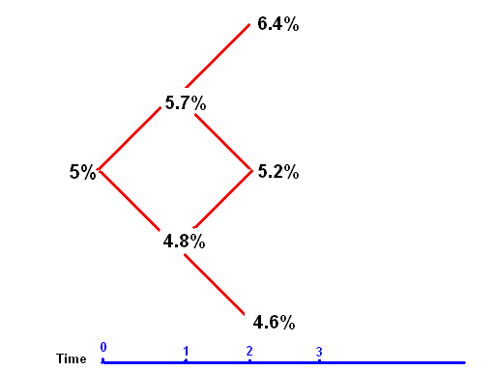
An Example
In the second year, there is also a 50% chance of rising or falling conditional on what happened the previous year: F(2,1)

Slide 19
Calculating the Yield Curve
S(1)
5.7%
Path 1: (1.05)(1.057) = 1.10985 (10.985%)
5%
4.8%
Path 2: (1.05)(1.048) = 1.10040 (10.04%)
Expected two year cumulative return
=
(.5)(1.10985) + (.5)(1.10040) = 1.105125 (10.5125%)
1/2
Annualized Return = (1.105125)
= 1.0512 (5.12%) = S(2)

Slide 20
6.4%
Path 1: (1.05)(1.057)(1.064) = 1.181 (18.1%)
5.7%
Path 2: (1.05)(1.057)(1.052) = 1.168 (16.8%)
5%
5.2%
Path 3: (1.05)(1.048)(1.052) = 1.157 (15.7%)
4.8%
4.6%
Path 4: (1.05)(1.048)(1.046) = 1.151 (15.1%)
Expected three year cumulative return
=
(.25)(1.181) + (.25)(1.168) + (.25)(1.157) +(.25)(1.151) = 1.164
1/3
Annualized Return = (1.164)
= 1.0519 (5.19%) = S(3)

Slide 21
Future Yield Curves
6.4%
5.7%
5%
5.2%
Path 1: (1.048)(1.052) = 1.1025 (10.25%)
4.8%
4.6%
Path 2: (1.048)(1.046) = 1.096 (9.6%)
Suppose that next months interest rate turns out to be 4.8% = S(1)’
(.5)(1.1025) + (.5)(1.096) = 1.0993(9.3%)
1/2
S(2)’ = (1.099)
= 1.049 (4.9%)

Slide 22
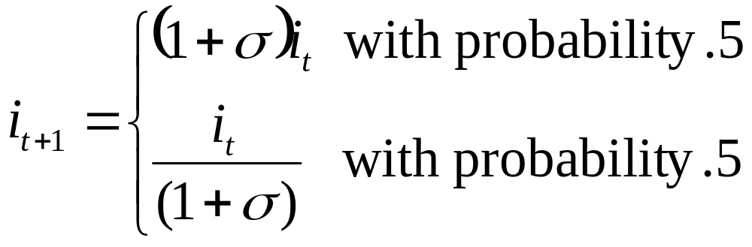
Volatility & Term Structure
A common form for a binomial tree is as follows:
Sigma is measuring volatility

Slide 23
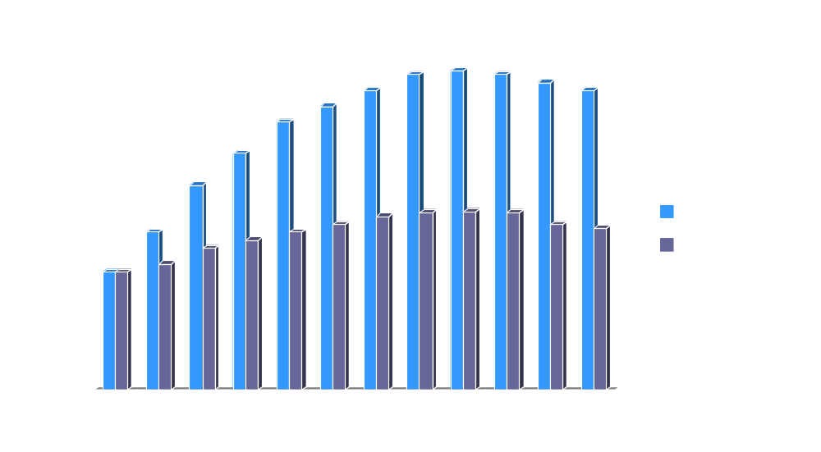
Higher volatility raises the probability of very large or very small future interest rates. This will be reflected in a steeper yield curve

Slide 24
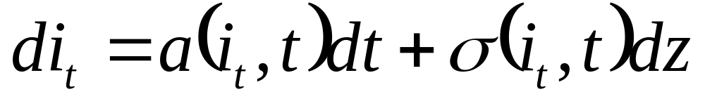
Continuous Time Models
Random Error term with N(0,1) distribution
Change in the interest rate at time ‘t’
Deterministic (Non-Random) component
Random component

Slide 25
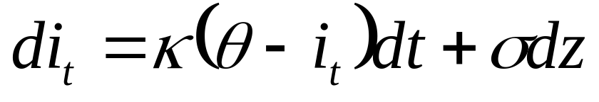
Vasicek
The Vasicek model is a particularly simple form:
Controls Persistence
Controls Variance
Controls Mean

Slide 26
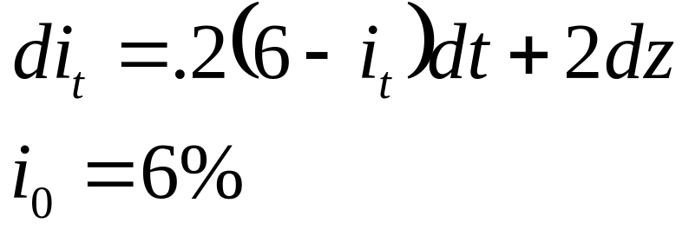
Using the Vasicek Model
Choose parameter values
Choose a starting value
Generate a set of random numbers with mean 0 and variance 1
 | t=0 | t=1 | t=2 | t=3 | t=4
i | 6% | 6.8% | 6.84% | 4.202% | 5.5616%
.2(6-i) | 0 | -.16 | -.168 | .3596
dz | .4 | .2 | -1.1 | .5
di | .8 | .04 | -2.368 | 1.3596 | -.9

Slide 27
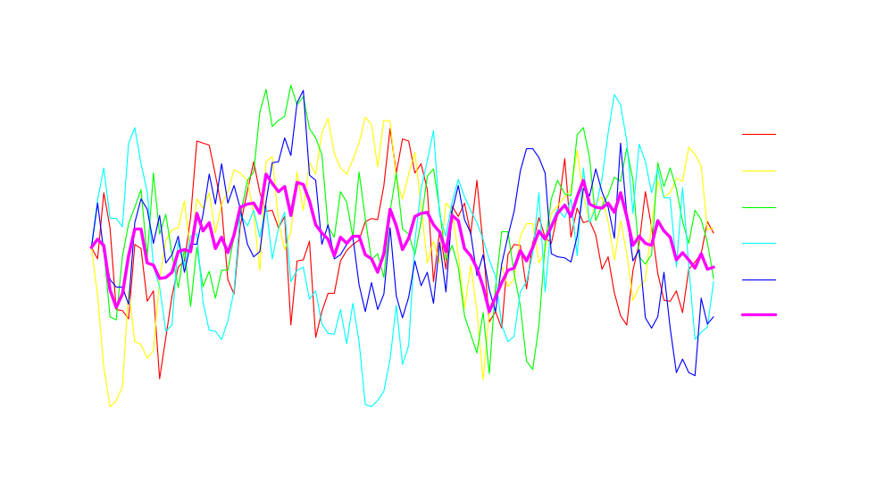
Vasicek (sigma = 2, kappa = .17)

Slide 28
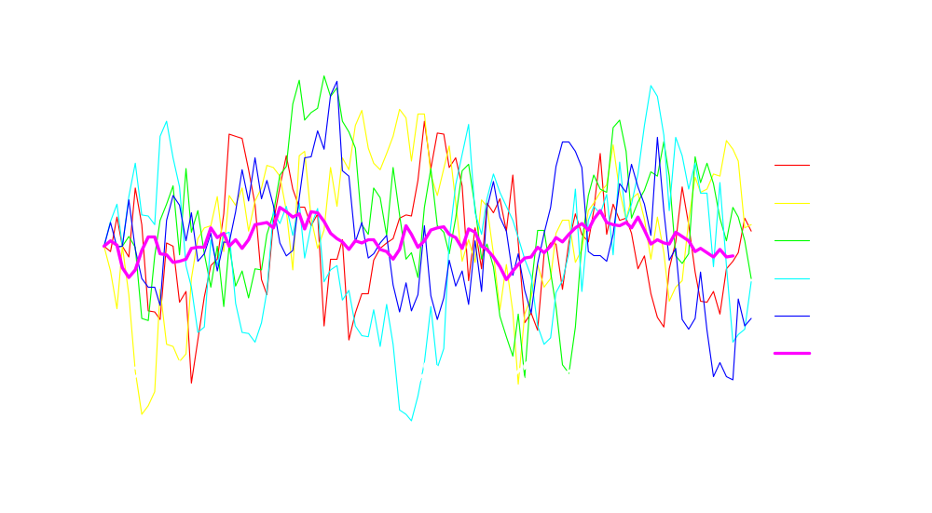
Vasicek (sigma = 4, kappa = .17 )

Slide 29
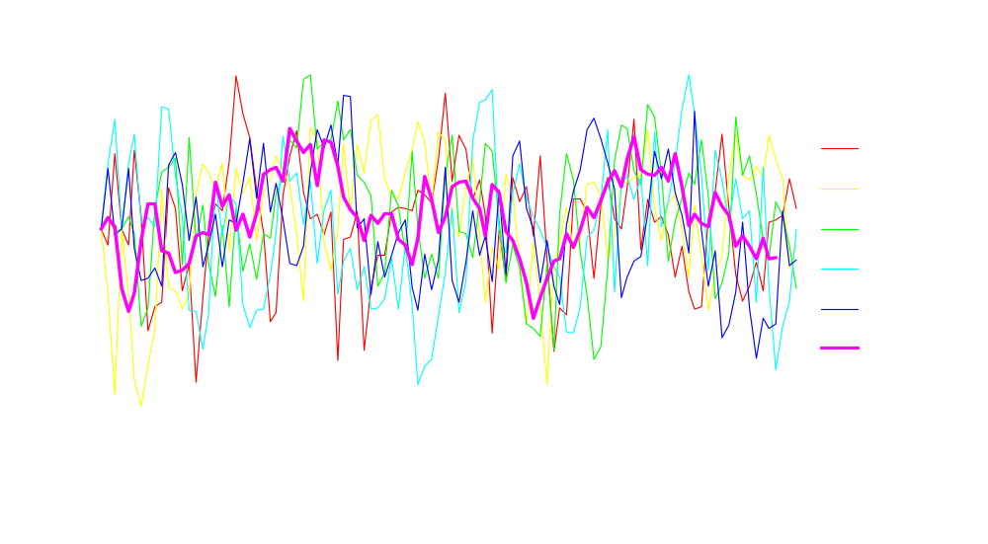
Vasicek (sigma = 2, kappa = .4)

Slide 30
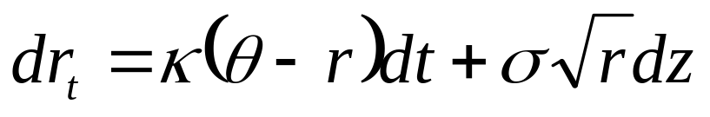
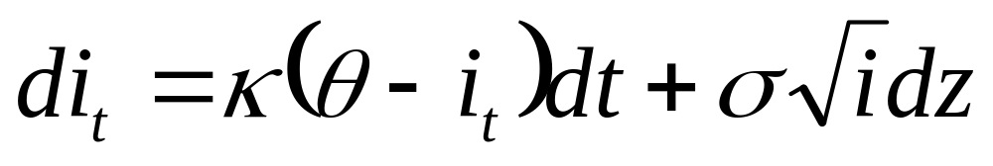
Cox, Ingersoll, Ross (CIR)
The CIR framework allows for volatility that depends on the current level of the interest rate (higher volatilities are associated with higher rates)

Slide 31
Heath,Jarow,Morton (HJM)
Vasicek and CIR assume a process for a single forward rate and then use that to construct the yield curve
In this framework, the correlation between different interest rates of different maturities in automatically one (as is the case with any one factor model)
HJM actually model the evolution of the entire array of forward rates
Change it the forward rate of maturity T ant time t

Slide 32
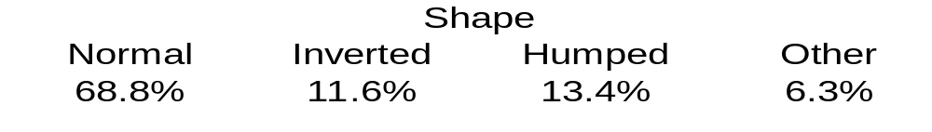
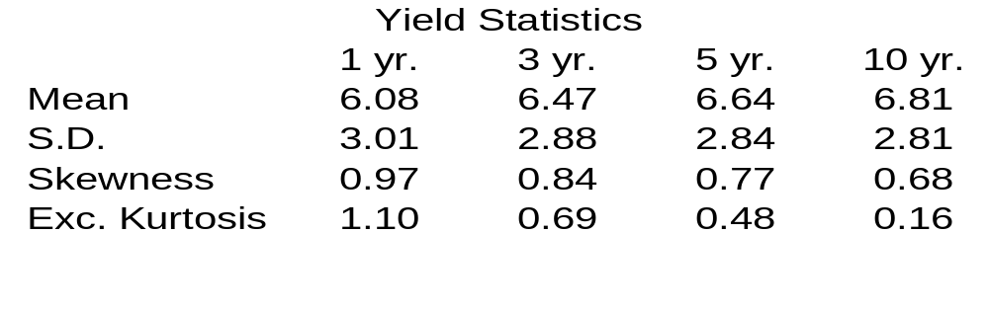
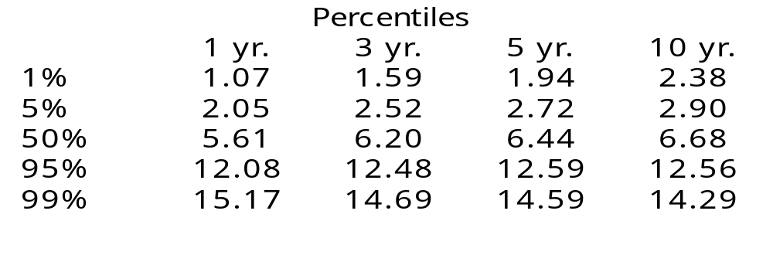
Table 1
Summary Statistics for Historical Rates
Tables 1-4 from Ahlgrim, D’Arcy, and Gorvett, CAS 1999 DFA Call Paper Program

Slide 33
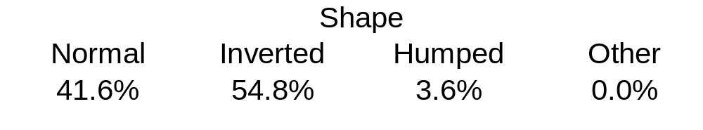
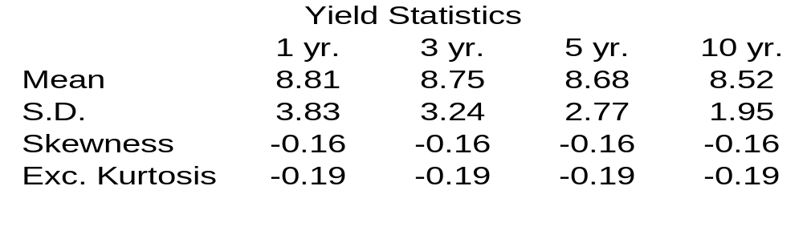
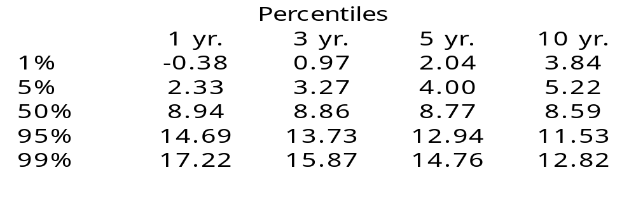
Table 2
Summary Statistics for Vasicek Model
Notes: Number of simulations = 10,000, κ = 0.1779, θ = 0.0866, σ = 0.0200

Slide 34
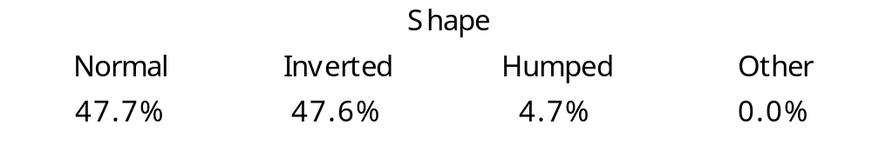
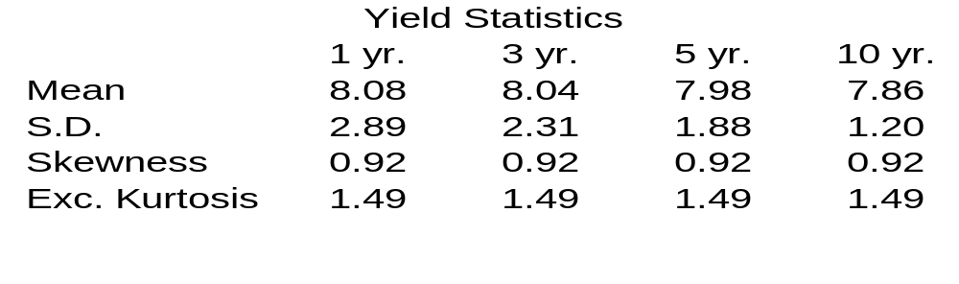
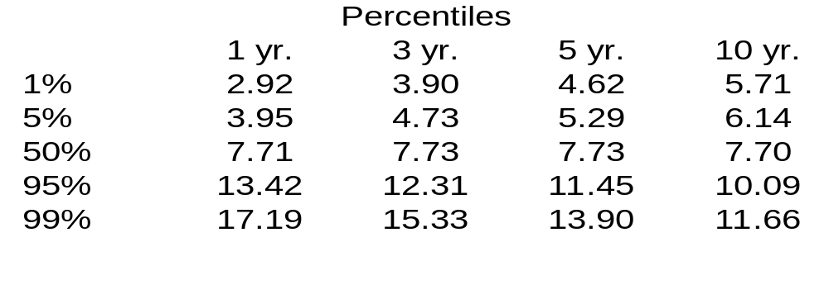
Table 3
Summary Statistics for CIR Model
Notes: Number of simulations = 10,000, κ = 0.2339, θ = 0.0808, σ = 0.0854

Slide 35
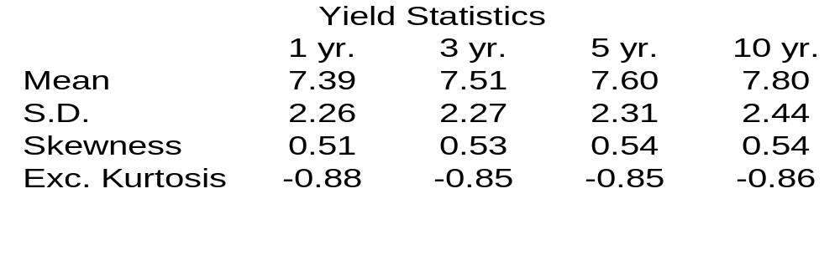
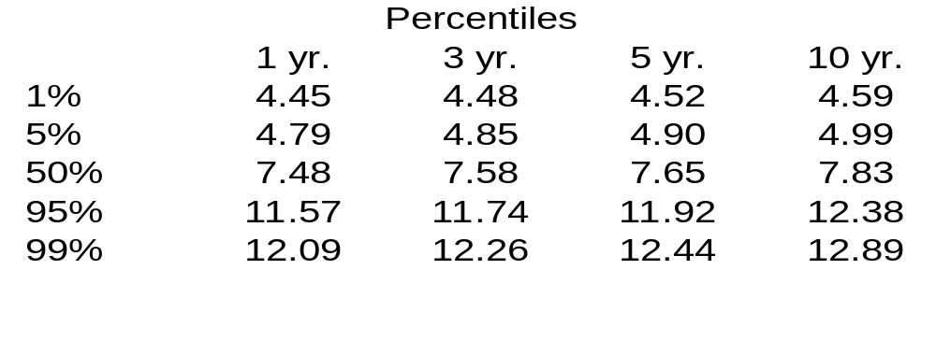
Table 4
Summary Statistics for HJM Model
Notes: Number of simulations = 100

